Slide 1
Context Sensitive Analysis
Intermediate Representations
Chapter-5 (Keith Cooper)
Nalinadevi Kadiresan, CSE DEPT.
AMRITA SCHOOL OF ENGG.

Slide 2
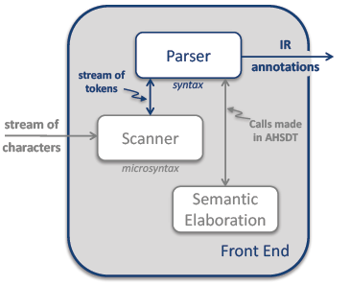
Role of Parser in Front End
A parser’s other(than syntax) activities can be termed “semantic elaboration.”
It may perform many tasks, including
  Type checking
  Code generation
  Storage layout
  Error checking
It might create an IR & interpret that IR to produce answers
It might pretty-print the code back to a file in some modified form.
Semantic elaboration makes parsers quite versatile tools.
Even Semester 2017-18
Nalinadevi Kadiresan

Slide 3
Intermediate Representations
Source
Code
Front
End
IR
Middle
End
IR
Back
End
Target
Code
Front end - produces an intermediate representation (IR)
Middle end - transforms the IR into an equivalent IR that runs more efficiently
Back end - transforms the IR into native code
IR encodes the compiler’s knowledge of the program
Middle end usually consists of several passes

Slide 4
Intermediate Representations
Decisions in IR design affect the speed and efficiency
of the compiler
Some important IR properties
  Ease of generation
  Ease of manipulation
  Procedure size
  Freedom of expression
  Level of abstraction
The importance of different properties varies between compilers
  Selecting an appropriate IR for a compiler is critical

Slide 5
Types of Intermediate Representations
Three major categories
Structural
  Graphically oriented
  Heavily used in source-to-source translators
  Tend to be large
Linear
  Pseudo-code for an abstract machine
  Level of abstraction varies
  Simple, compact data structures
  Easier to rearrange
Hybrid
  Combination of graphs and linear code
  Example: control-flow graph
Examples:
Trees, DAGs
Examples:
3 address code
Stack machine code
Example:
Control-flow graph

Slide 6
Level of Abstraction
The level of detail exposed in an IR influences the profitability and feasibility of different optimizations.
Two different representations of an array reference:
loadI 1 => r₁
sub r_{j}, r₁ => r₂
loadI 10 => r₃
mult r₂, r₃ => r₄
sub r_{i}, r₁ => r₅
add r₄, r₅ => r₆
loadI @A => r₇
Add r₇, r₆ => r₈
load r₈ => r_{Aij}
subscript
A
i
j
High level AST:
Good for memory
disambiguation
Low level linear code:
Good for address calculation

Slide 7
Level of Abstraction
Structural IRs are usually considered high-level
Linear IRs are usually considered low-level
Not necessarily true:
load
loadArray A,i,j
Low level AST
+
High level linear code
+
@A
*
-
-
10
j
1
j
1

Slide 8
Abstract Syntax Tree
An abstract syntax tree is the procedure’s parse tree with the nodes for most non-terminal nodes removed
x - 2 * y
Can use linearized form of the tree
  Easier to manipulate than pointers
  x 2 y * - in postfix form
  - * 2 y x in prefix form
S-expressions are (essentially) ASTs
-
x
*
2
y

Slide 9
Directed Acyclic Graph
A directed acyclic graph (DAG) is an AST with a unique node for each value
Makes sharing explicit
Encodes redundancy
←
←
z
-
w
/
z ← x - 2 * y
w ← x / 2
x
*
2
y
Same expression twice means that the compiler might arrange to evaluate it just once!

Slide 10
Stack Machine Code
Originally used for stack-based computers, now Java
Example:
x - 2 * y becomes
Advantages
Compact form
Introduced names are implicit, not explicit
Simple to generate and execute code
Useful where code is transmitted over slow communication links (the net )
push x
push 2
push y
multiply
subtract
Implicit names take up no space, where explicit ones do!

Slide 11
Three Address Code
Several different representations of three address code
In general, three address code has statements of the form:
  x ← y op z
  With 1 operator (op ) and, at most, 3 names (x, y, & z)
Example:
  z ← x - 2 * y becomes
Advantages:
Resembles many machines
Introduces a new set of names
Compact form
t ← 2 * y
z ← x - t
*

Slide 12
Instructions in Three-Address Code - 1
Assignment instructions:
a = b biop c, a = uop b, and a = b (copy), where
  biop is any binary arithmetic, logical, or relational operator
  uop is any unary arithmetic (-, shift, conversion) or logical operator ()
  Conversion operators are useful for converting integers to floating point numbers, etc.
Jump instruction
goto L (unconditional jump to L),
if t goto L (it t is true then jump to L),
if a relop b goto L (jump to L if a relop b is true), where
  L is the label of the next three-address instruction to be executed
  t is a boolean variable
  a and b are either variables or constants

Slide 13
Instructions in Three-Address Code - 2
Functions:
  func begin <name> (beginning of the function),
  func end (end of a function),
  param p (place a value parameter p on stack),
  refparam p (place a reference parameter p on stack),
  call f, n (call a function f with n parameters),
  return (return from a function),
  return a (return from a function with a value a)
Indexed copy instructions:
  a = b[i] (a is set to contents(contents(b)+contents(i)), where b is (usually) the base address of an array
  a[i] = b (ith location of array a is set to b)
Pointer assignments:
  a = &b (a is set to the address of b, i.e., a points to b)
  *a = b (contents(contents(a)) is set to contents(b))
  a = *b (a is set to contents(contents(b)))

Slide 14
Three Address Code: Quadruples
Naïve representation of three address code
Table of k * 4 small integers
Simple record structure
Easy to reorder
Explicit names
The original FORTRAN compiler used “quads”
load | 1 | Y
loadi | 2 | 2
mult | 3 | 2 | 1
load | 4 | X
sub | 5 | 4 | 2
load r1, y
loadI r2, 2
mult r3, r2, r1
load r4, x
sub r5, r4, r3
RISC assembly code
Quadruples

Slide 15
Three Address Code: Triples
Index used as implicit name
25% less space consumed than quads
Much harder to reorder
(1)
load | y
loadI | 2
mult | (1) | (2)
load | x
sub | (4) | (3)
(2)
(3)
(4)
load r1, y
loadI r2, 2
mult r3, r2, r1
load r4, x
sub r5, r4, r3
(5)
RISC assembly code
Implicit names take no space!

Slide 16
Three Address Code: Indirect Triples
List first triple in each statement
Implicit name space
Uses more space than triples, but easier to reorder
Major tradeoff between quads and triples is compactness versus ease of manipulation
  In the past compile-time space was critical
  Today, speed may be more important
(100)
33
34
35
36
37
(100)
load | y
loadI | 2
mult | (100) | (101)
load | x
sub | (103) | (102)
(101)
(101)
(102)
(102)
(103)
(103)
(104)
(104)

Slide 17
Two Address Code
Allows statements of the form
x ← x op y
  Has 1 operator (op ) and, at most, 2 names (x and y)
Example:
z ← x - 2 * y becomes
Can be very compact
Problems
Machines no longer rely on destructive operations
Difficult name space
  Destructive operations make reuse hard
  Good model for machines with destructive ops (PDP-11)
t₁ ← 2
t₂ ← load y
t₂ ← t₂ * t₁
z ← load x
z ← z - t₂

Slide 18
Static Single Assignment Form
The main idea: each name defined exactly once
Introduce φ-functions to make it work
SSA-form
x₀ ←0
y₀ ←1
if (x₀ > k) goto next
loop: x₁ ← φ(x₀,x₂)
y₁ ← φ(y₀,y₂)
x₂ ← x₁ + 1
y₂ ← y₁ + x₂
if (x₂ < k) goto loop
next: …
Original
x ←0
y ←1
while (x < k)
x ← x + 1
y ← y + x
Strengths of SSA-form
Sharper analysis
φ-functions give hints about placement
(sometimes) faster algorithms

Slide 19
Control-flow Graph
Models the transfer of control in the procedure
Nodes in the graph are basic blocks
  Can be represented with quads or any other linear representation
Edges in the graph represent control flow
Example
if (x = y)
Basic blocks —
Maximal length sequences of straight-line code
a ← 2
b ← 5
a ← 3
b ← 4
c ← a * b

Slide 20
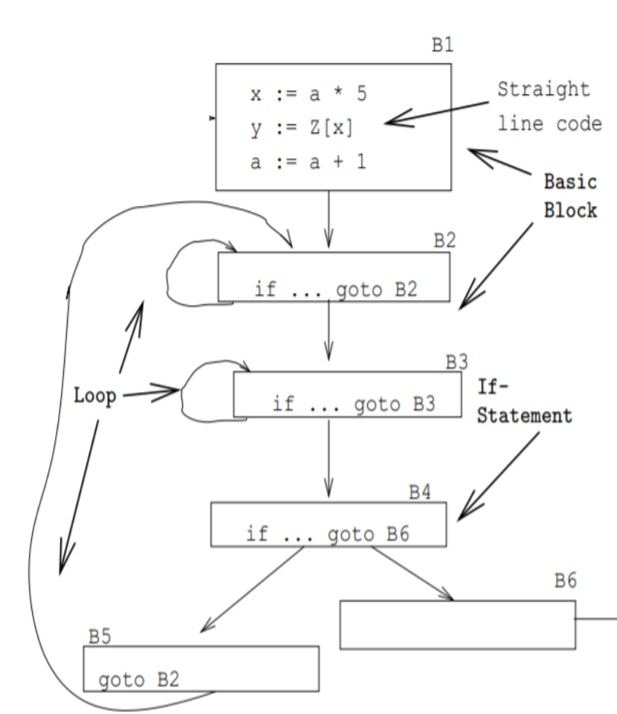
Control-Flow Graph
Divide the intermediate code of each procedure into basic blocks. A basic block is a piece of straight line code, i.e. there are no jumps in or out of the middle of a block..
The basic blocks within one procedure are organized as a (control) flow graph, or CFG. A flow-graph has basic blocks B1 · · · Bn as nodes, a directed edge B1 → B2 if control can flow from
Inside each basic block can be any of the IRs we’ve seen: tuples, trees, DAGs, etc.B1 to B2.

Slide 21
Constructing a CFG
To construct a CFG where each node is a basic block
  Identify leaders: first statement of a basic block
  In program order, construct a block by appending subsequent statements up to, but not including, the next leader
Identifying leaders
  The first three-address instruction in the intermediate code is a leader.
  Explicit targets : Any instruction that is the target of a conditional or unconditional jump is a leader.
  Implicit targets: Any instruction that immediately follows a conditional or unconditional jump is a leader.
Explicit targets: targets mentioned in jump statement
Implicit targets: statements that follow conditional jump statements
• The statement that gets executed if the branch is no
taken
All the statements that follows the leader (including the leader itself) till just before the next leader appears forms one basic block.
The block containing the first leader which is the first statement of the code is called as initial block.
IR and Symbol Table 1

Slide 22
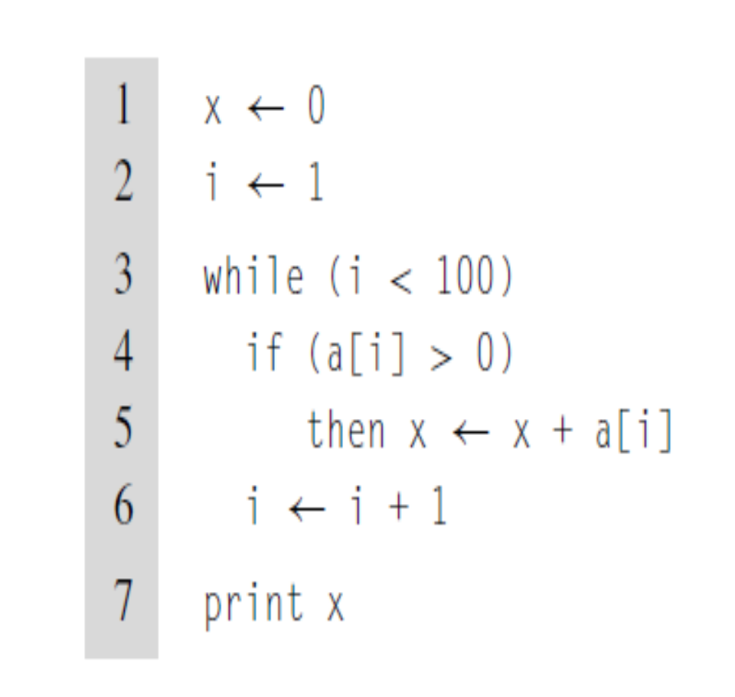
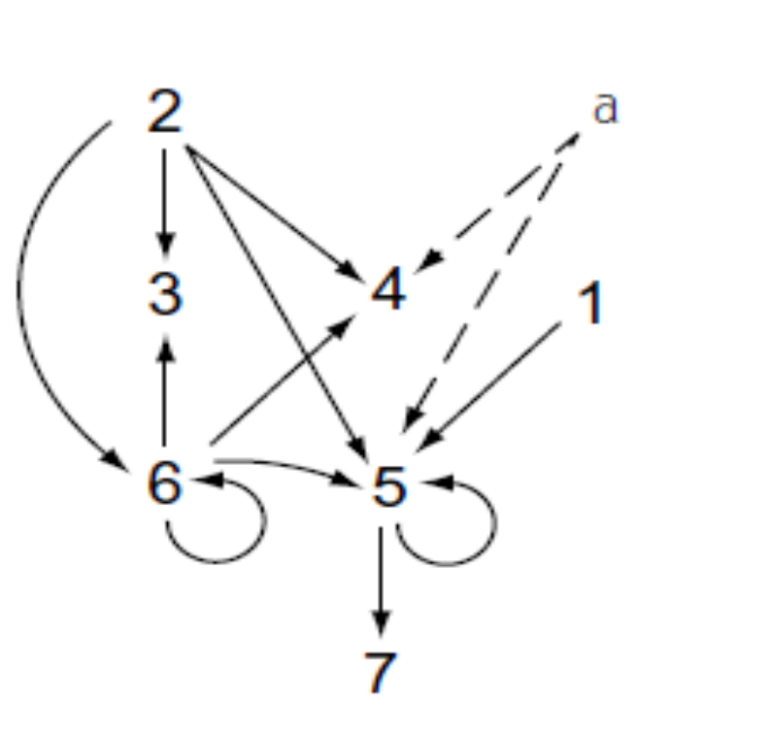
Dependency Graph
Even Semester 2017-18
Nalinadevi Kadiresan

Slide 23
Using Multiple Representations
Source
Code
Front
End
IR 1
Middle
End
IR 2
Middle
End
IR 3
Back
End
Target
Code
Repeatedly lower the level of the intermediate representation
  Each intermediate representation is suited towards certain optimizations
Example: the Open64 compiler
  WHIRL intermediate format
    Consists of 5 different IRs that are progressively more detailed

Slide 24
Memory Models
Two major models
Register-to-register model
  Keep all values that can legally be stored in a register in registers
  Ignore machine limitations on number of registers
  Compiler back-end must insert loads and stores
Memory-to-memory model
  Keep all values in memory
  Only promote values to registers directly before they are used
  Compiler back-end can remove loads and stores
Compilers for RISC machines usually use register-to-register
  Reflects programming model
  Easier to determine when registers are used

Slide 25
The Rest of the Story…
Representing the code is only part of an IR
There are other necessary components
Symbol table (already discussed)
Constant table
  Representation, type
  Storage class, offset
Storage map
  Overall storage layout
  Overlap information
  Virtual register assignments

Slide 26
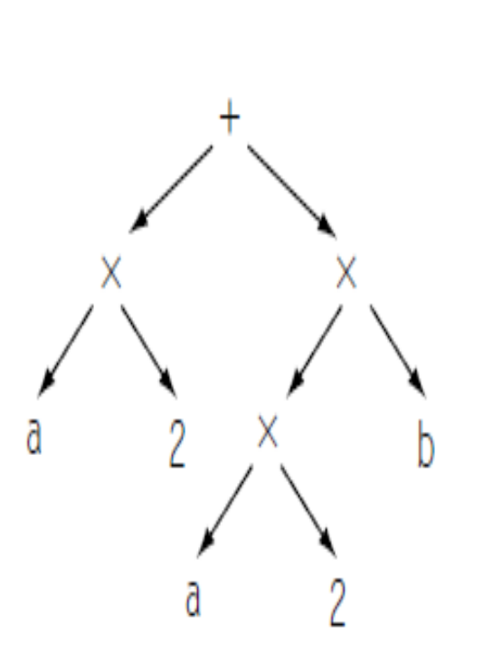
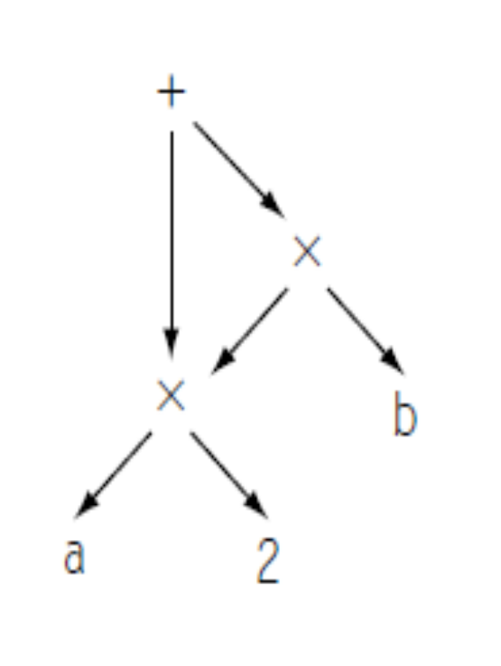
Problems
Example -1: a × 2 + a × 2 × b
AST DAG
Even Semester 2017-18
Nalinadevi Kadiresan

Slide 27
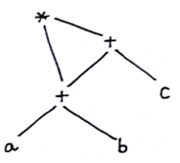
Problems
Example -2: ( a + b ) x ( a + b + c )
DAG 3-address Code
T3
T1 = a + b
T2 = T1 + c
T3 = T1 x T2
T2
T1
Even Semester 2017-18
Nalinadevi Kadiresan

Slide 28
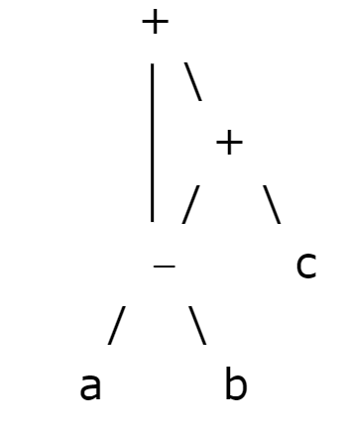
Problems
Example -3: (a-b)+((a-b)+c)
DAG 3-address Code
T3
T1 = a - b
T2 = T1 + c
T3 = T1 + T2
T2
T1
Even Semester 2017-18
Nalinadevi Kadiresan

Slide 29

Problems
Example -4: ( ( ( a + a ) + ( a + a ) ) + ( ( a + a ) + ( a + a ) ) )
DAG 3-address Code
T3
T1 = a + a
T2 = T1 + T1
T3 = T2 + T2
T2
T1
Even Semester 2017-18
Nalinadevi Kadiresan

Slide 30
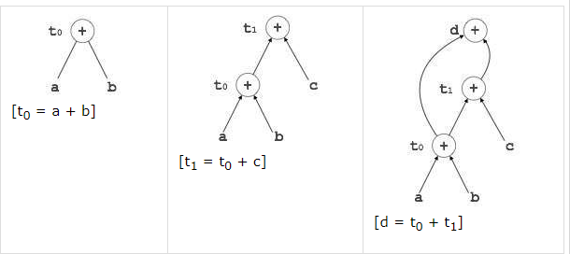
Problems
Example -5: Convert 3- address code to DAG
DAG 3-address Code
t0 = a + b
t1 = t0 + c
d = t0 + t1
Even Semester 2017-18
Nalinadevi Kadiresan

Slide 31
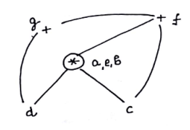
Problems
Example -6: Convert 3- address code to DAG
DAG 3-address Code
(1) a = b x c
(2) d = b
(3) e = d x c
(4) b = e
(5) f = b + c
(6) g = f + d
Even Semester 2017-18
Nalinadevi Kadiresan

Slide 32
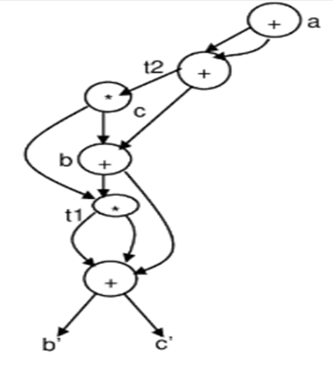
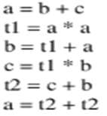
Problems
Example -7: Convert 3- address code to DAG
DAG 3-address Code
Even Semester 2017-18
Nalinadevi Kadiresan

Slide 33
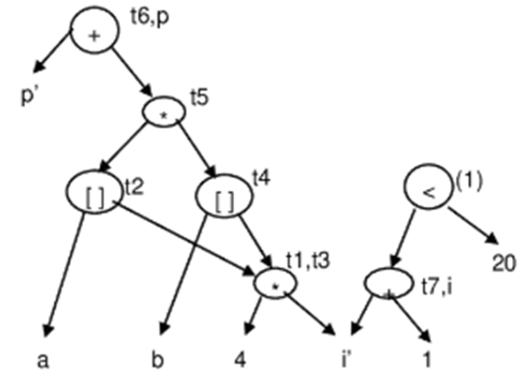
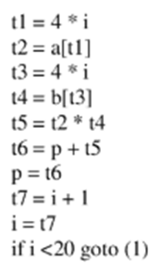
Problems
Example -8: Convert 3- address code to DAG
DAG 3-address Code
Even Semester 2017-18
Nalinadevi Kadiresan

Slide 34
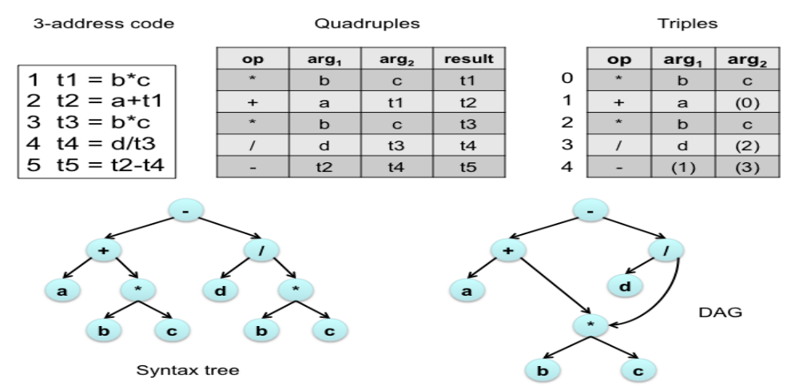
Problems
Example -9: Convert a + b* c – d / b * c to AST, DAG, 3- address code, Triples( direct and indirect) and quadruples
Even Semester 2017-18
Nalinadevi Kadiresan

Slide 35
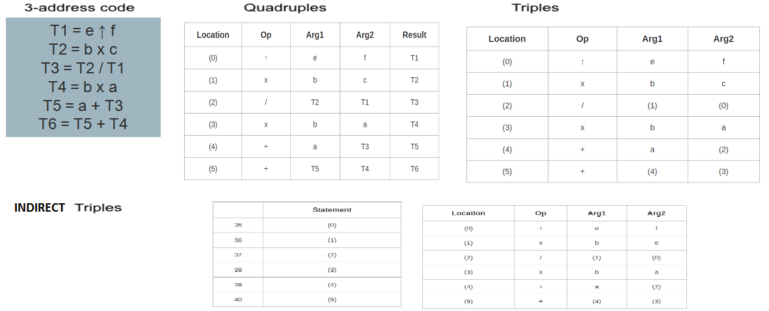
Problems
Example -10: Convert a + b x c / e ↑ f + b x a to quadruple, triple and indirect triple
Even Semester 2017-18
Nalinadevi Kadiresan

Slide 36
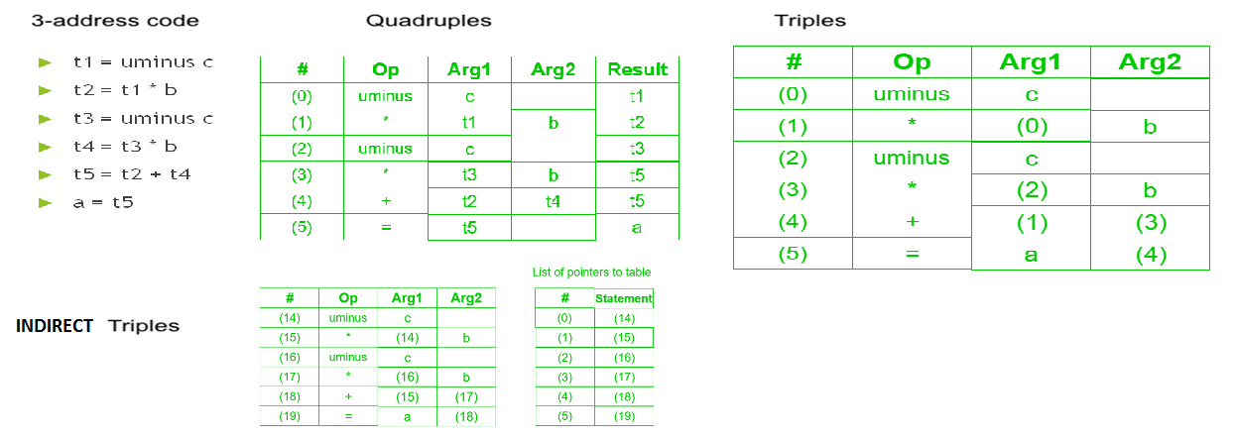
Problems
Example -11: Convert a = b * – c + b * – c to quadruple, triple and indirect triple
Even Semester 2017-18
Nalinadevi Kadiresan

Slide 37
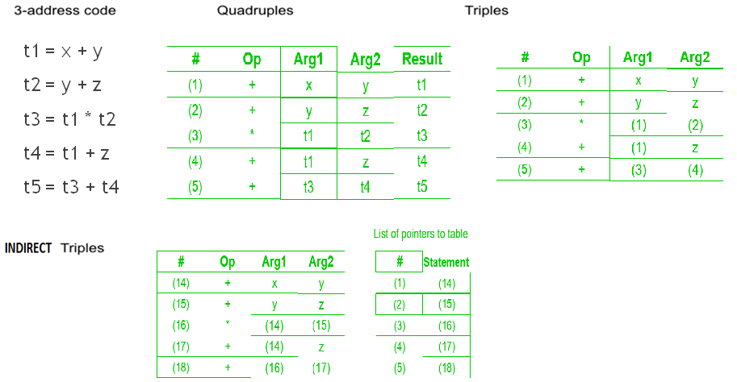
Problems
Example -12: Convert (x + y) * (y + z) + (x + y + z)to quadruple, triple and indirect triple
Even Semester 2017-18
Nalinadevi Kadiresan

Slide 38
Problems
Example -13: Convert the following if stmt to 3-address code
x=1
If(x>1)
y=y+3
3-address code
  x=1
  If x<=1 goto L1
  y=y+3
L1:
Even Semester 2017-18
Nalinadevi Kadiresan

Slide 39
Problems
Example -14: Convert the following if stmt to 3-address code
x=5
If(x<1)
z=z+3
Else
y=y*2
3-address code
x=5
If x>=1 goto L1
z=z+3
goto L2
L1 : y=y*2
L2 :
Even Semester 2017-18
Nalinadevi Kadiresan

Slide 40
Problems
Example -15: Convert the following if stmt to 3-address code
x=1
do
{
x=x+1
}while(x<=5)
3-address code
x=1
L1 : x=x+1
If x<=5 goto L1
Even Semester 2017-18
Nalinadevi Kadiresan

Slide 41
Problems
Example -16: Convert the following if stmt to 3-address code
x=1
While(x<10)
{
y=y*2
x=x+1
}
3-address code
x=1
L2 : If x>10 goto L1
y=y*2
x=x+1
goto L2
L1:
Even Semester 2017-18
Nalinadevi Kadiresan

Slide 42
Problems
Example -17: Convert the following if stmt to 3-address code
for(x=1;x<10;x++)
y=y*2
3-address code
x=1
L2 : If x>=10 goto L1
y=y*2
x=x+1
goto L2
L1:
Even Semester 2017-18
Nalinadevi Kadiresan

Slide 43
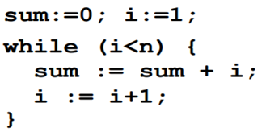
Problems
Example -18: Convert the following if stmt to 3-address code
3-address code
sum=0
i=1
L2 : If i >= n goto L1
t1=sum + i
sum=t1
t2=i+1
i=t2
goto L2
L1:
Even Semester 2017-18
Nalinadevi Kadiresan

Slide 44
Problems
Example -19: Convert the following if stmt to 3-address code
3-address code
i=1
L2 : If x>10 goto L1
t1=x * 5
a[i]=t1
t2=i+1
i=t2
goto L2
L1:
for(i = 1; i<=10; i++)
{
a[i] = x * 5;
}
Even Semester 2017-18
Nalinadevi Kadiresan

Slide 45
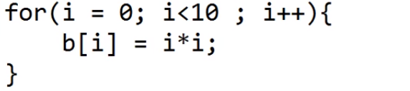
Problems
Example -20: Convert the following if stmt to 3-address code
3-address code
i=0
L2 : If i>=10 goto L1
t1=i*i
b[i]=t1
t2=i+1
i=t2
goto L2
L1:
Even Semester 2017-18
Nalinadevi Kadiresan

Slide 46
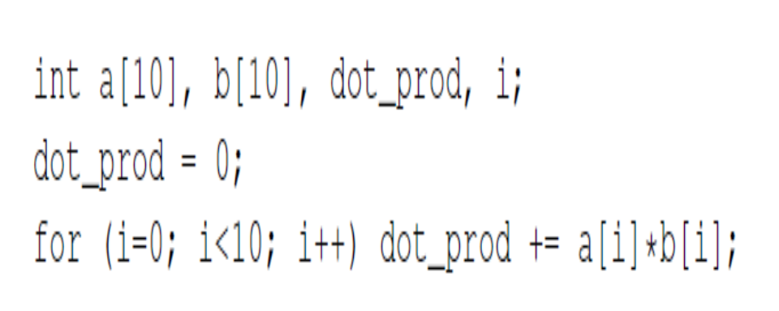
Problems
Example -21: Convert the following if stmt to 3-address code
3-address code
dot_prod=0
i=0
L2 : If i>=10 goto L1
t1=a[i]
t2=b[i]
t3=t2 * t3
t4= dot_prod + t3
dot_prod=t4
goto L2
L1:
Even Semester 2017-18
Nalinadevi Kadiresan

Slide 47
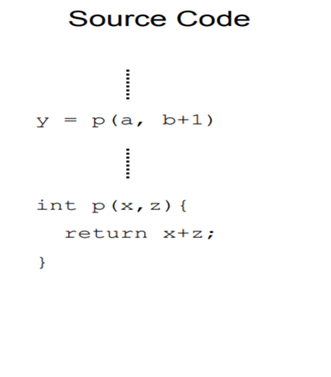
Problems
Example -22: Convert the following if stmt to 3-address code
3-address code
………
t1=a
t2=b+1
call p, t1, t2
………
funcbegin p
  param x
  param z
  t3=x+z
  return t3
funcend
Even Semester 2017-18
Nalinadevi Kadiresan

Slide 48
Problems
Example -23: Convert the following if stmt to 3-address code
3-address code
dp=0
i=0
L2 : If i>=10 goto L1
t1=a[i]
t2=b[i]
t3=t2 * t3
t4= dp + t3
dp=t4
goto L2
L1:
int a[10],b[10],i,dp=0
for(i=0;i<10;i++)
dp+=a[i]*b[i]
Even Semester 2017-18
Nalinadevi Kadiresan

Slide 49
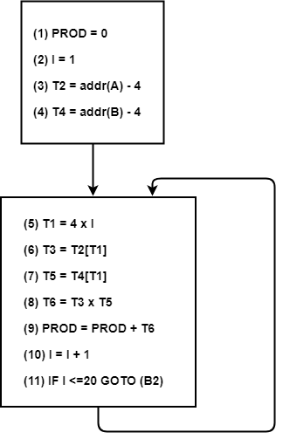
Problems
Example -24: Convert the following to CFG
3-address code
(1) PROD = 0
(2) I = 1
(3) T2 = addr(A) – 4
(4) T4 = addr(B) – 4
(5) T1 = 4 x I
(6) T3 = T2[T1]
(7) T5 = T4[T1]
(8) T6 = T3 x T5
(9) PROD = PROD + T6
(10) I = I + 1
(11) IF I <=20 GOTO (5)
Even Semester 2017-18
Nalinadevi Kadiresan

Slide 50
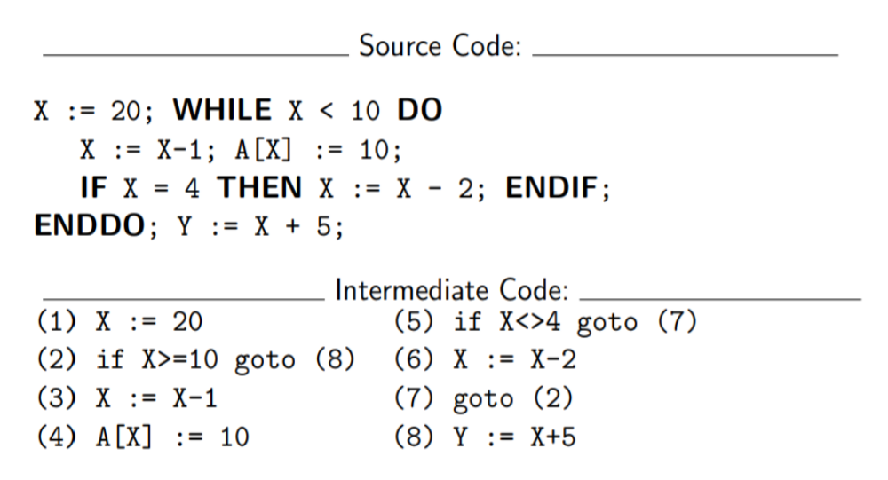
Problems
Example -25: Convert the following to CFG
Even Semester 2017-18
Nalinadevi Kadiresan

Slide 51
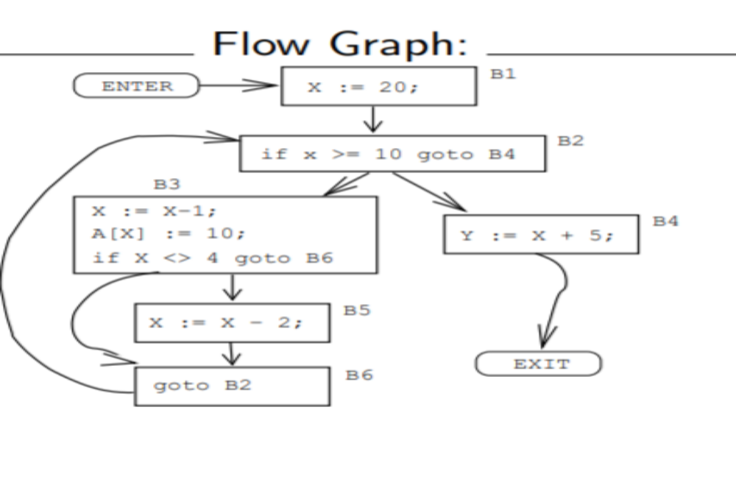
Even Semester 2017-18
Nalinadevi Kadiresan

Slide 52
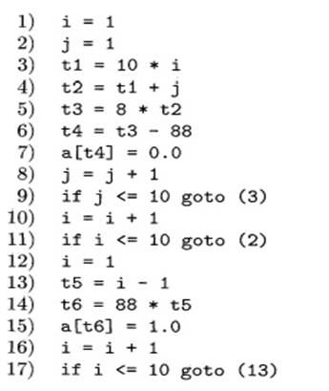
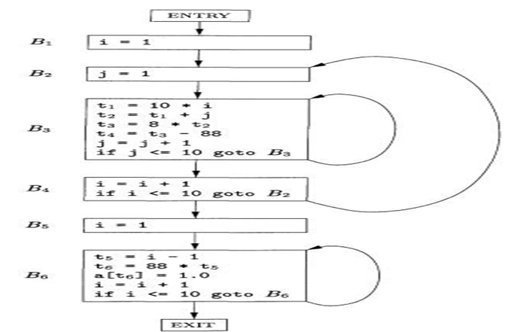
Problems
Example -26: Convert the following to CFG
Even Semester 2017-18
Nalinadevi Kadiresan

Slide 53
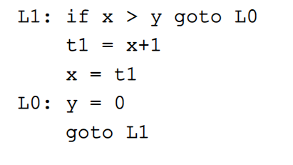
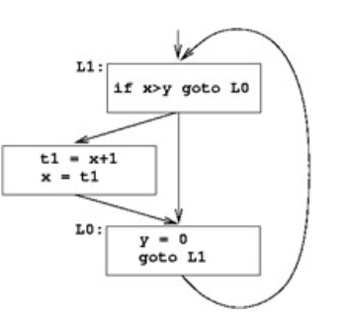
Problems
Example -27: Convert the following to CFG
Even Semester 2017-18
Nalinadevi Kadiresan

Slide 54
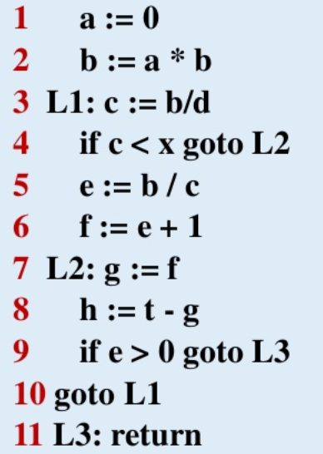
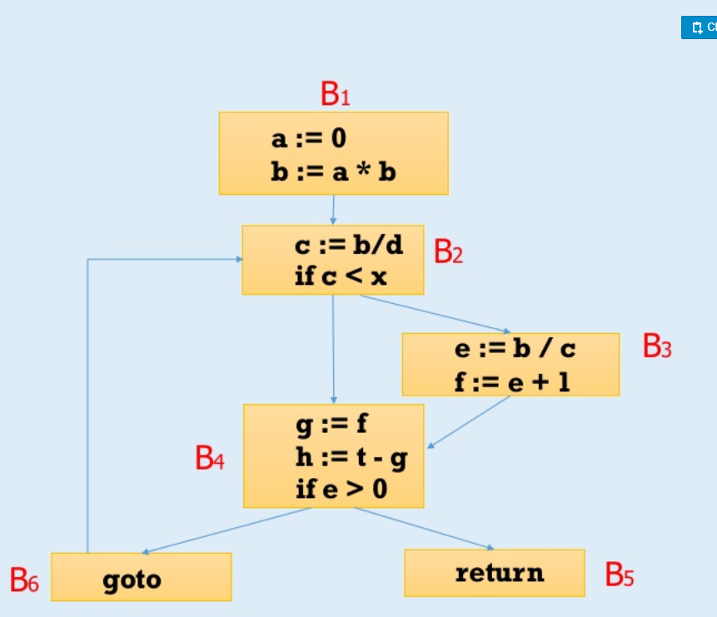
Problems
Example -28: Convert the following to CFG
Even Semester 2017-18
Nalinadevi Kadiresan

Slide 55
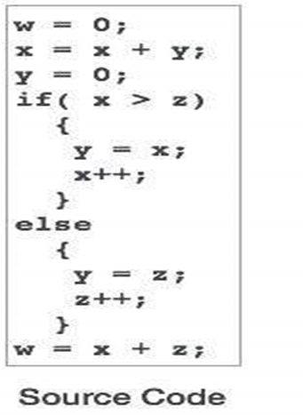
Problems
Example -29: Convert the following to CFG
Even Semester 2017-18
Nalinadevi Kadiresan

Slide 56
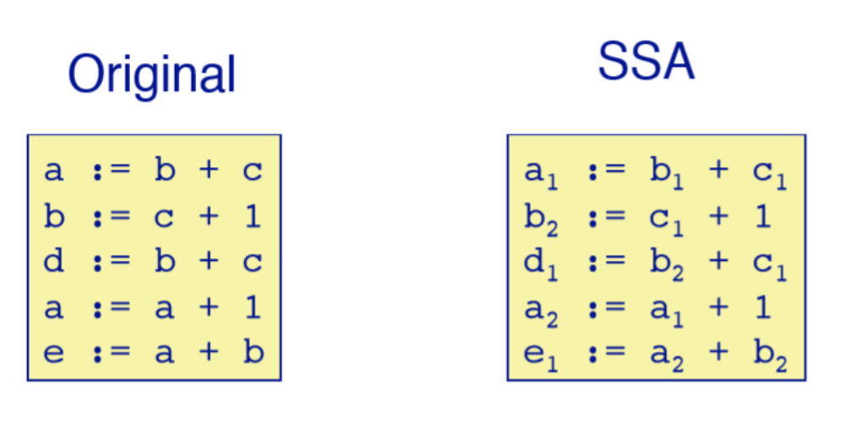
Problems
Example -30: Convert the following to SSA
Even Semester 2017-18
Nalinadevi Kadiresan

Slide 57
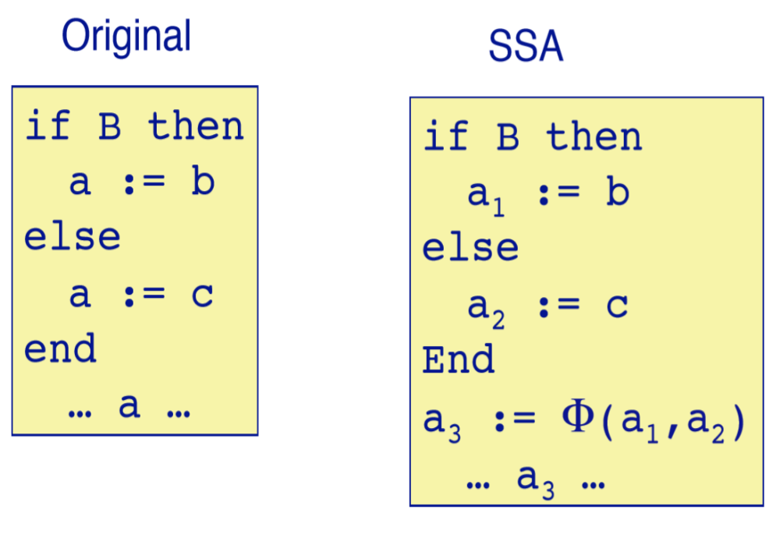
Problems
Example -31: Convert the following to SSA
Even Semester 2017-18
Nalinadevi Kadiresan

Slide 58
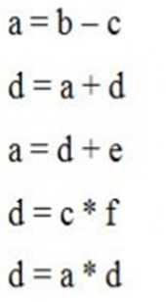
Problems
Example -32: Convert the following to SSA
SSA
a0 = b0 – c0
d1 = a0 + d0
a1 = d1 + e0
d2 = c0 * f0
d3 = a1 * d2
Even Semester 2017-18
Nalinadevi Kadiresan

Slide 59
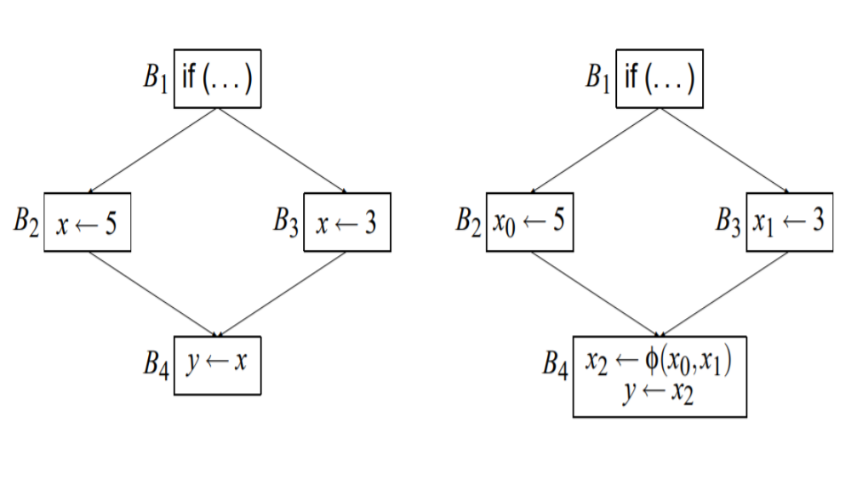
Problems
Example -33: Convert the following to SSA
Even Semester 2017-18
Nalinadevi Kadiresan

Slide 60
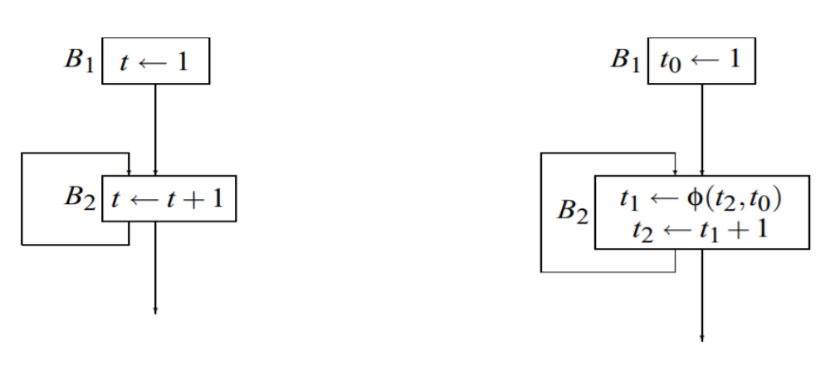
Problems
Example -34: Convert the following to SSA
Even Semester 2017-18
Nalinadevi Kadiresan

Slide 61
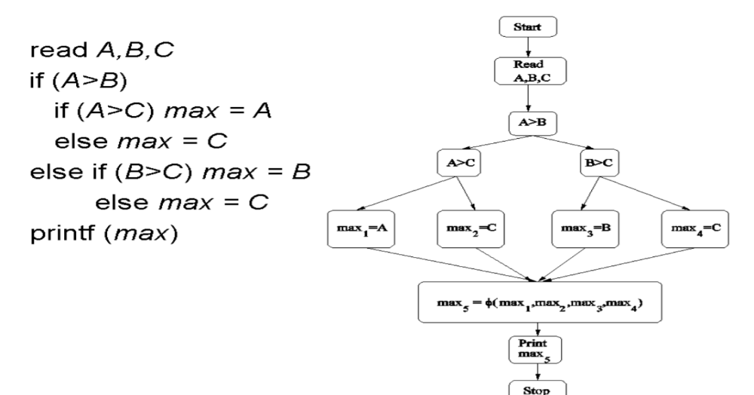
Problems
Example -35: Convert the following to SSA
Even Semester 2017-18
Nalinadevi Kadiresan

Slide 62
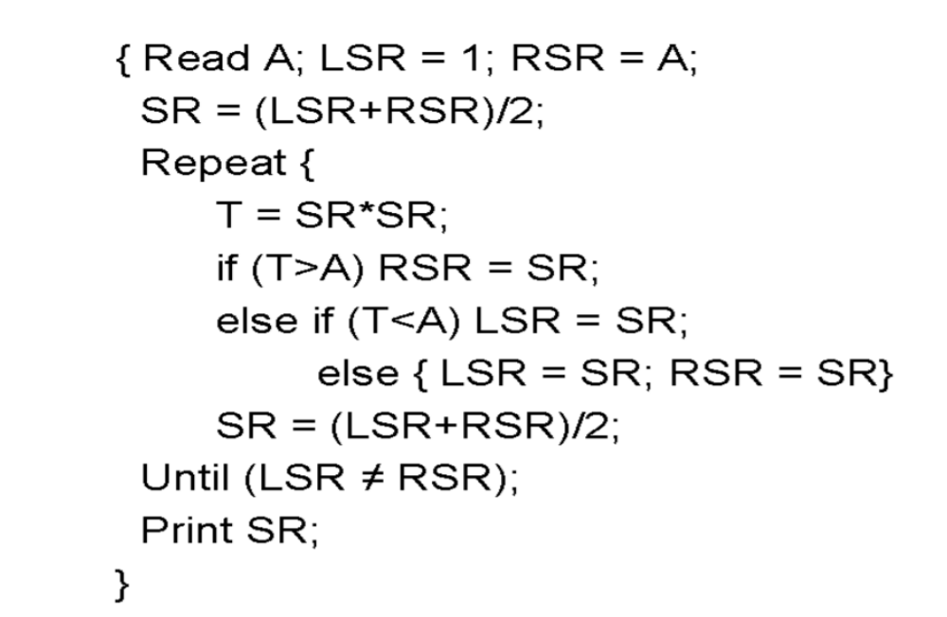
Problems
Example -36: Convert the following to SSA
Even Semester 2017-18
Nalinadevi Kadiresan

Slide 63
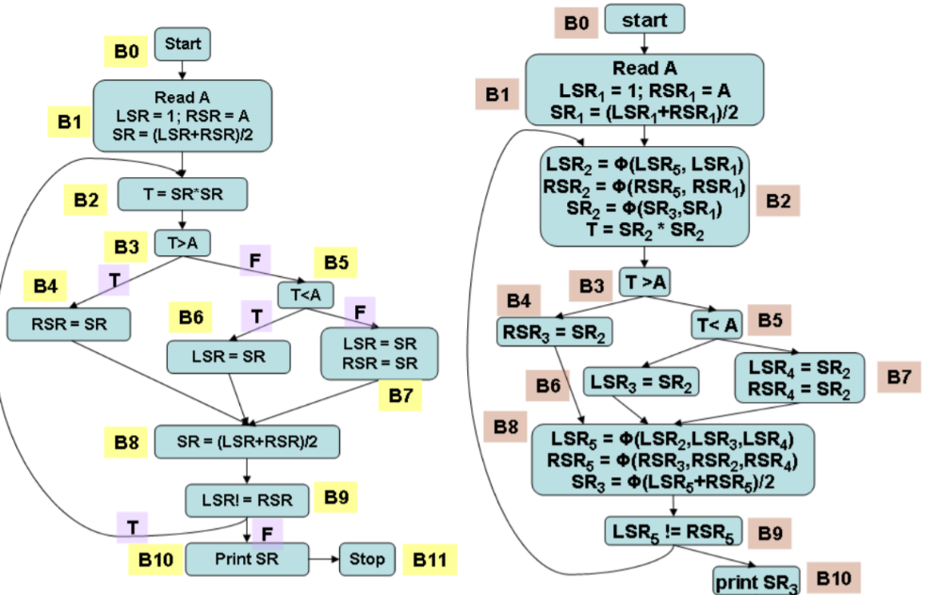
Even Semester 2017-18
Nalinadevi Kadiresan

Slide 64
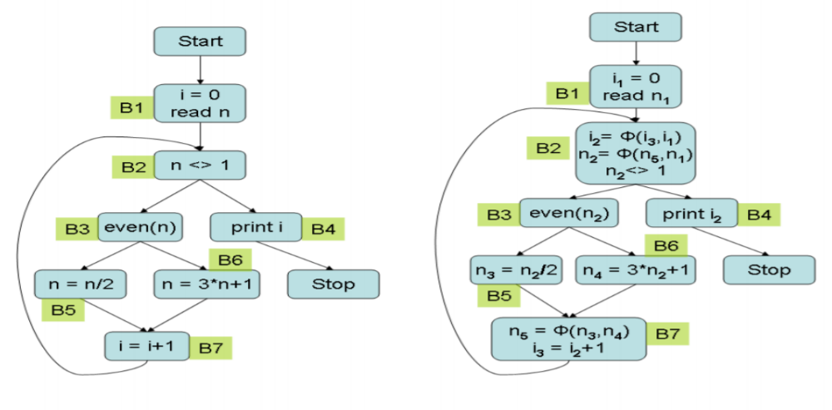
Problems
Example -37: Convert the following to SSA
Even Semester 2017-18
Nalinadevi Kadiresan

Slide 65
Problems
Example -38: Convert the following to SSA
B1
i1 ← 1
j 1← 1
k1← 0
i=1;
j=1;
k=0;
while(k<100)
{
if(j<20)
{
j=i;
k=k+1;
}
else
{
j=k;
k=k+2;
}
}
return j;
}
j2 ← φ(j4,j1)
k2 ← φ(k4,k1)
if k2<100
B2
B3
if j2<20
return j2
B4
B5
j 3← i
k3 ← k2+1
B6
j 5← k
k5 ← k2+2
B7
j4= φ(k3,k5)
k4 ← φ(k3,k5)
Even Semester 2017-18
Nalinadevi Kadiresan

